Slide 1
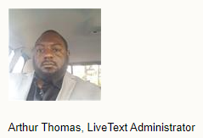
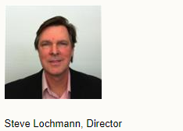
New faculty Assessment Orientation
August 24, 2021

Slide 2
Why do we aSSESs student learning outcomes?
(check out bottom of UAPB home page)

Slide 3
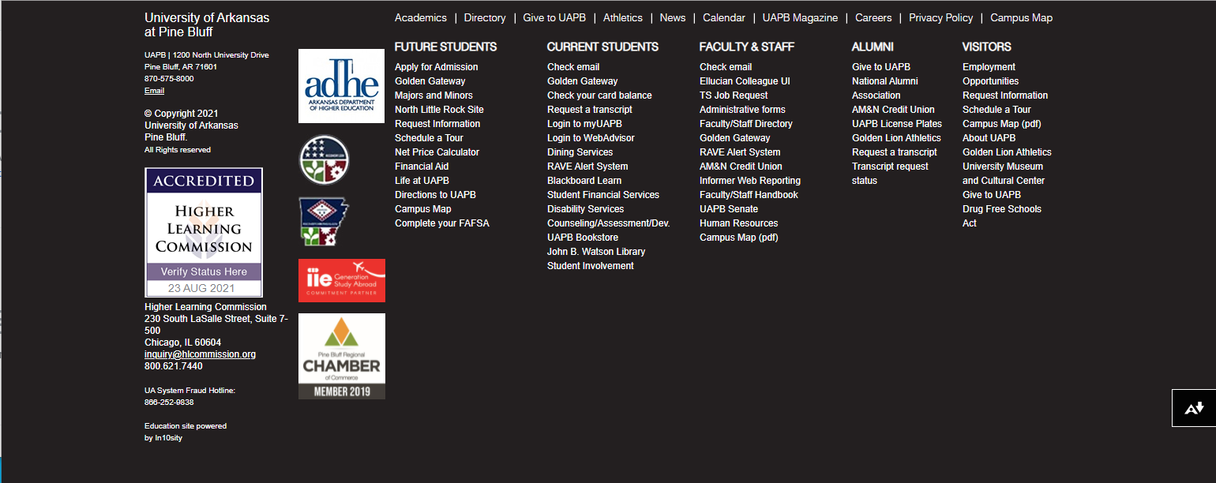
Why do we aSSESs student learning outcomes?
Accreditation
(check out bottom left of UAPB home page)

Slide 4
Why do we aSSESs student learning outcomes?
Accreditation

Slide 5
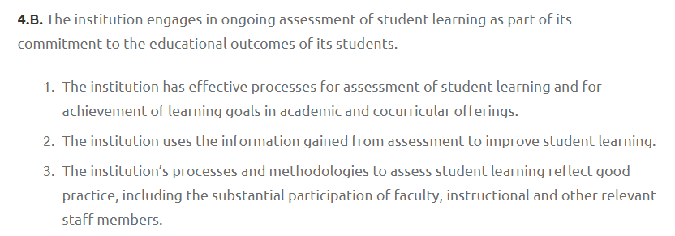
Why do we aSSESs student learning outcomes?
Accreditation

Slide 6
Why do we aSSESs student learning outcomes?
Accreditation
Improvement

Slide 7
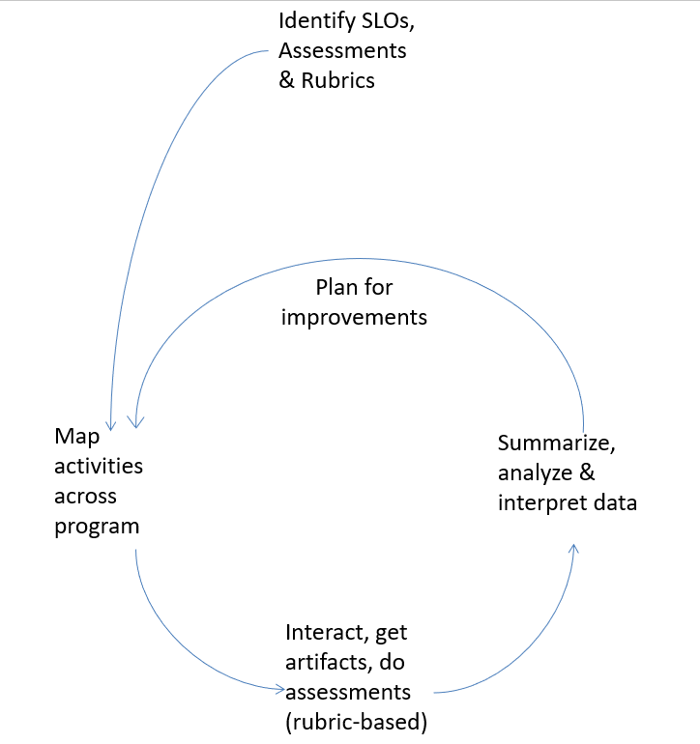
ASSESSMENT AND IMPROVEMENT: A Great Big 6

Slide 8
Institutional SLOs
Written Communication
Reading

Slide 9
Institutional SLOs
Oral Communication
Critical Thinking

Slide 10
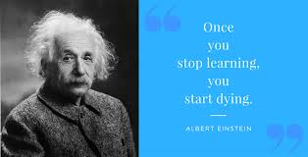
Institutional SLOs
Problem Solving
Teamwork
Lifelong Learning

Slide 11
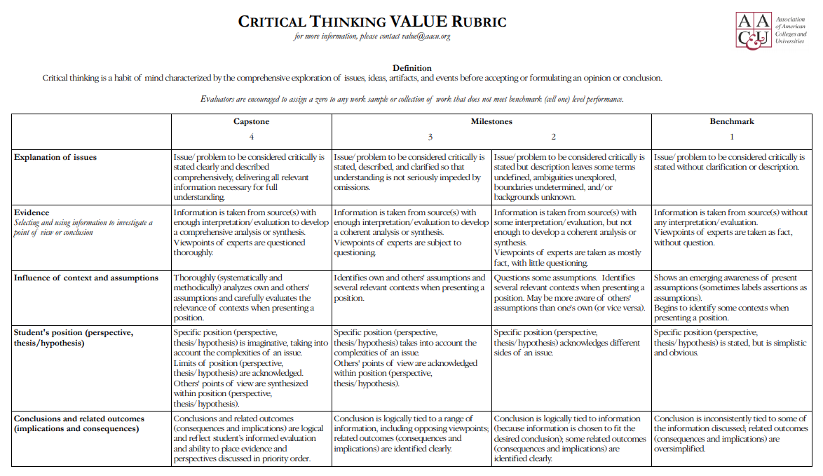

Slide 12
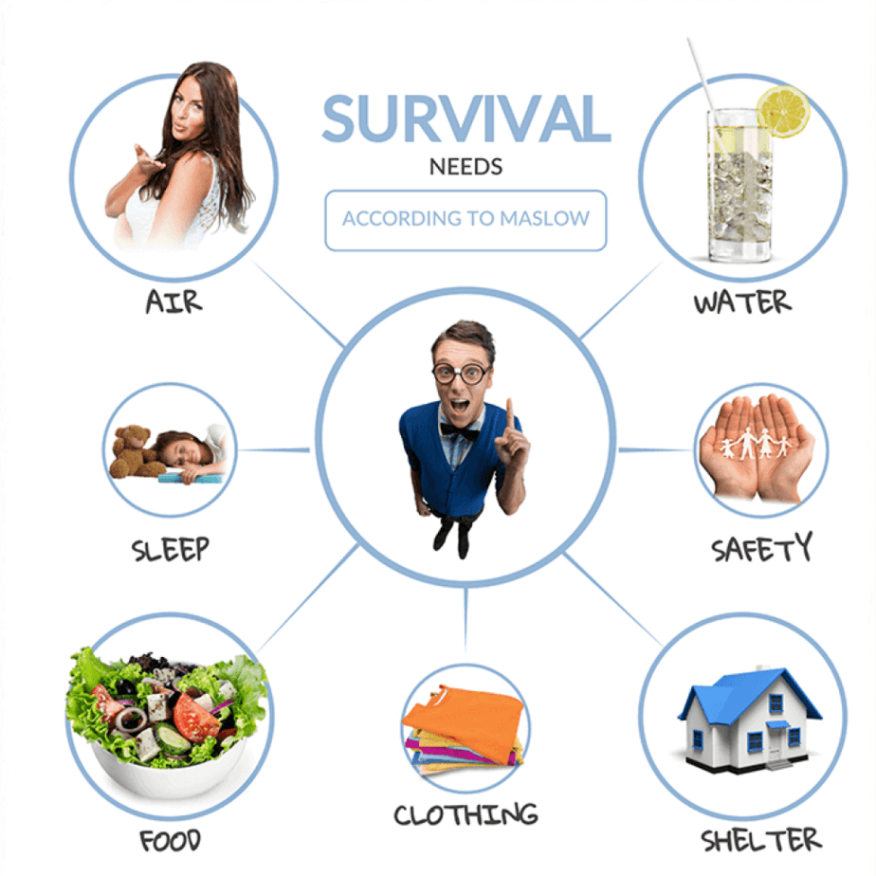
School SLOs
e.g. SAFHS -
Global Learning
Human Needs and the Global Environment

Slide 13
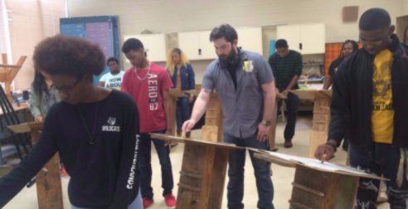
Art B.S. SLO
Students “use visual art elements and principles of design to create original works of art.”

Slide 14
ASSESSMENT AND IMPROVEMENT: A Great Big 6

Slide 15
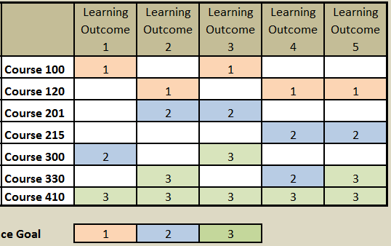
Curriculum maps
Matrix with Rows and Columns
Columns are SLOs
Rows are classes
Cells are Assignments (introduce, reinforce, assess mastery)

Slide 16
ASSESSMENT AND IMPROVEMENT: A Great Big 6

Slide 17
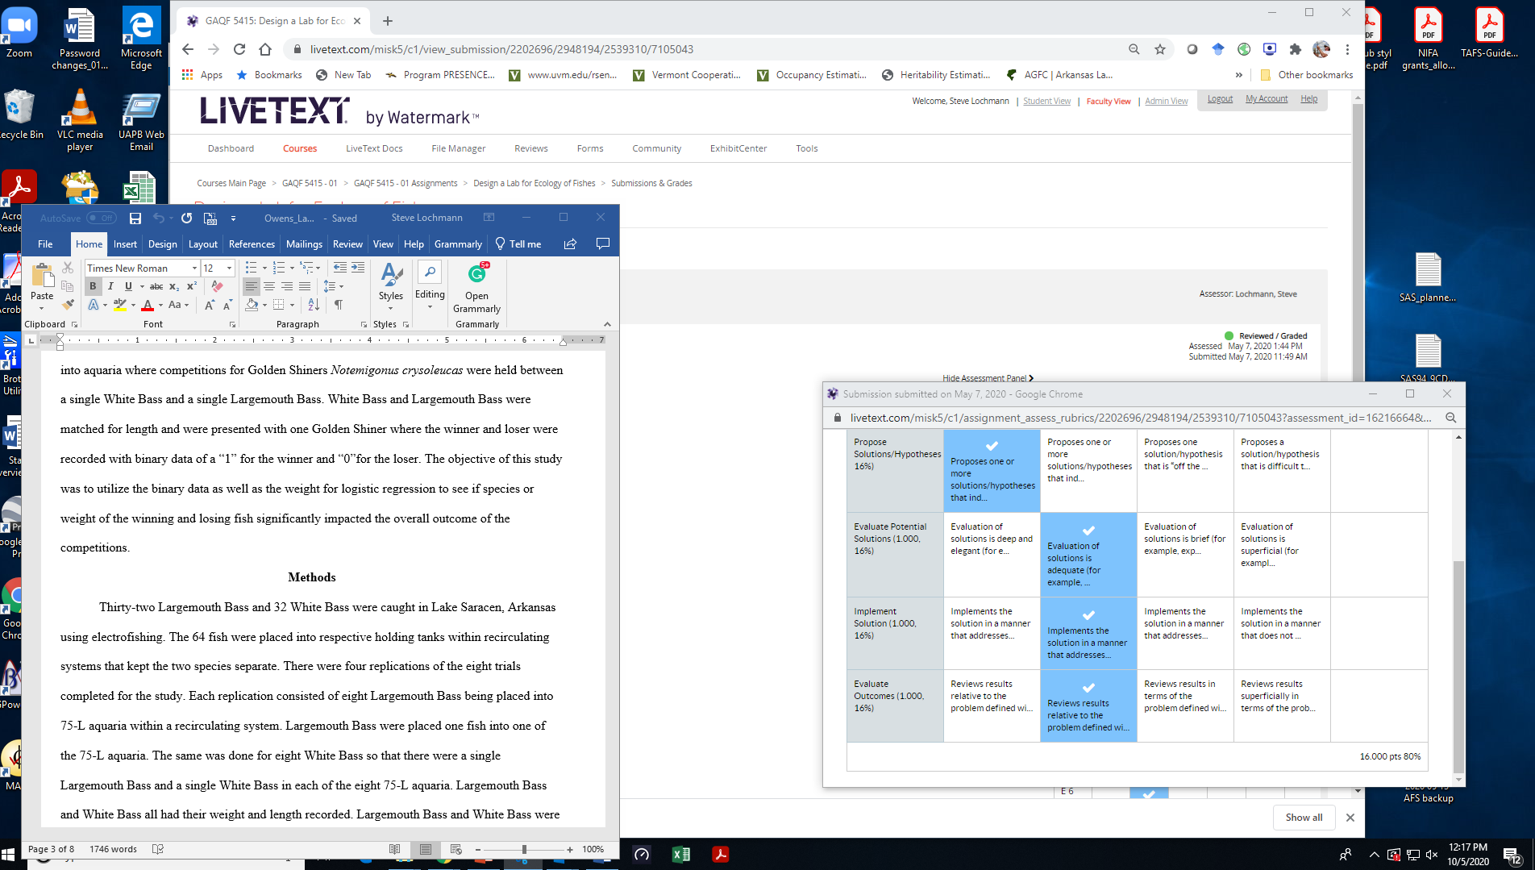

Slide 18
ASSESSMENT AND IMPROVEMENT: A Great Big 6

Slide 19
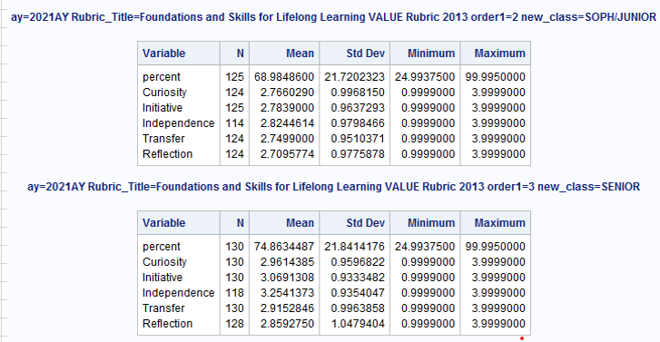

Slide 20
ASSESSMENT AND IMPROVEMENT: A Great Big 6
PLANS FOR IMPROVING OUTCOMES
What did assessment data show?
What will be done to improve outcomes?

Slide 21
Why do we assess student learning outcomes?
Accreditation
Improvement

Slide 22
How do we aSSESs student learning outcomes?
Articulate SLOs
Map SLOs across your curriculum
Rubric-based Assessments (in LiveText)
Plan for improvement based on data

Slide 23
Livetext and rubric-based assessment
Mr. Arthur Thomas, LiveText Administrator

Slide 27
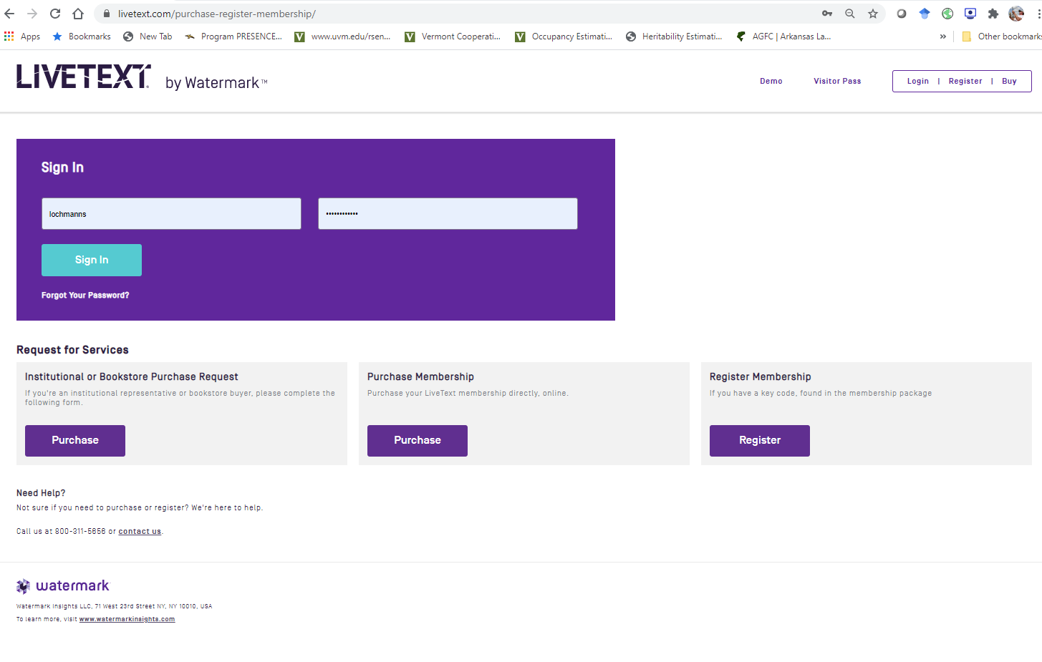

Slide 28
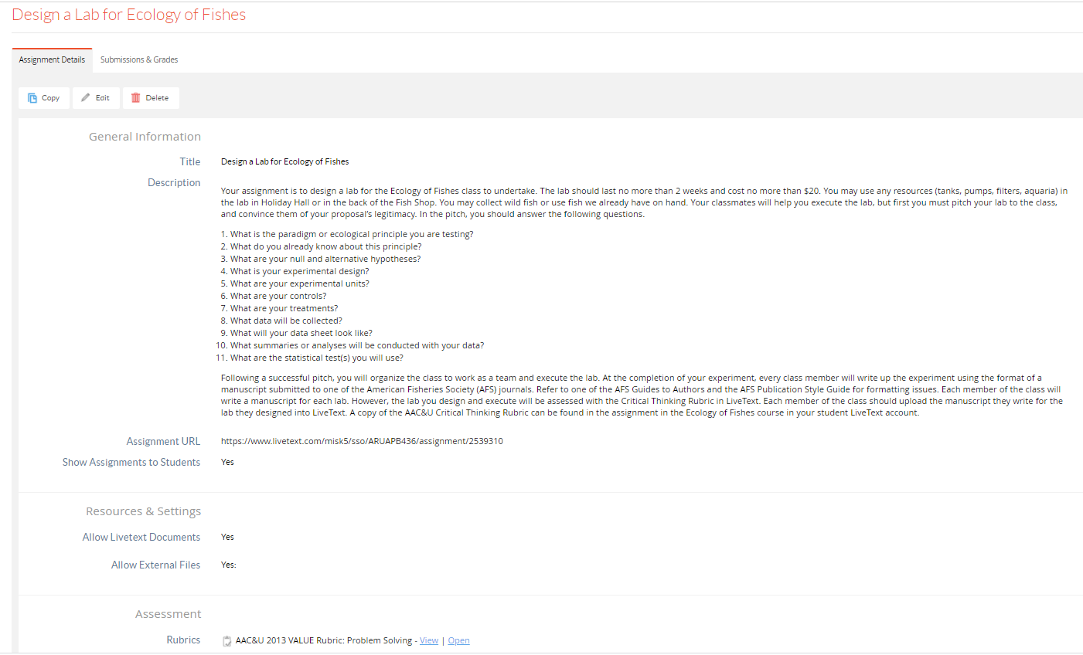

Slide 30
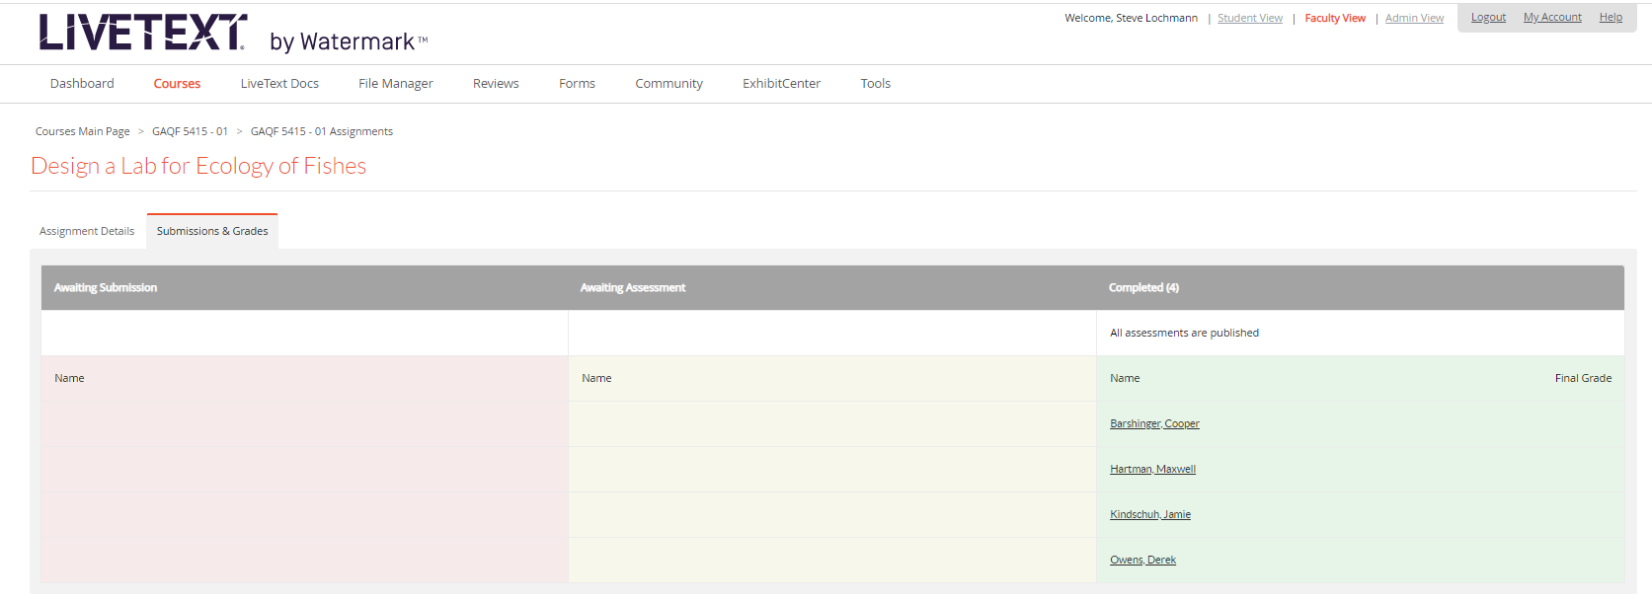

Slide 31
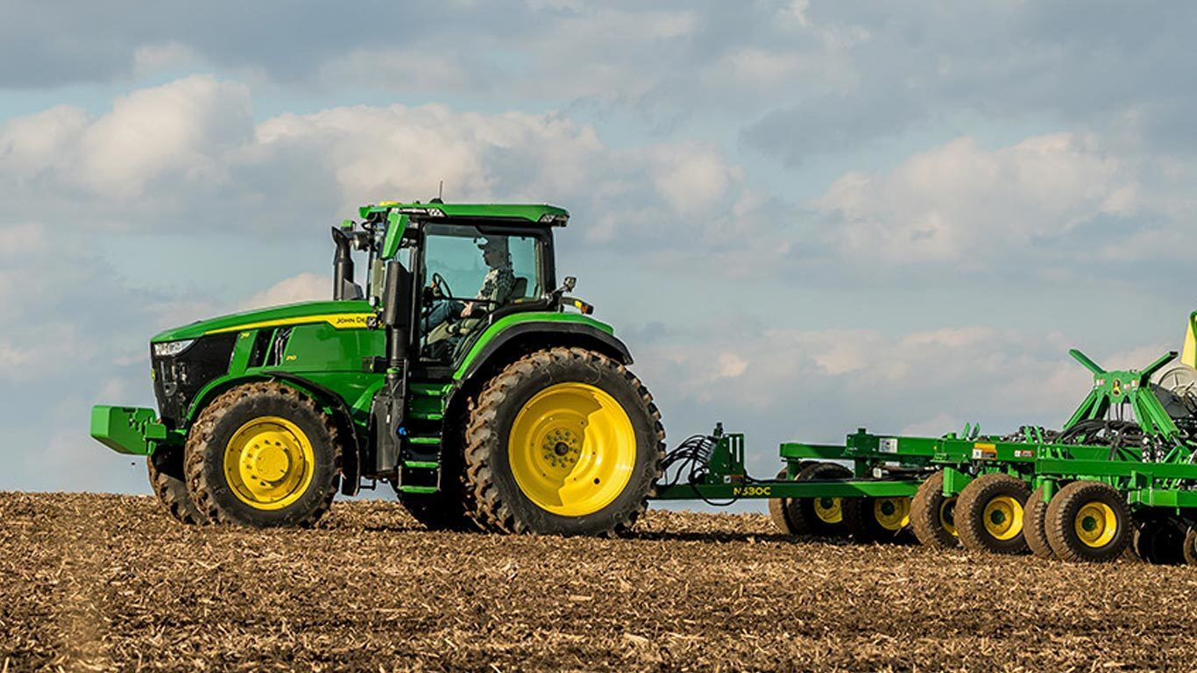
AGRI Degree Program SLOs
Ag Sci – Global agricultural production practices and processes
Reg Sci – Regulatory compliance associated with food, agricultural, industrial, health and environment safety
Ag Eng – new program

Slide 32
AQFI Degree Program SLOs
Aq & Fish Sci - Oral Communication

Slide 33
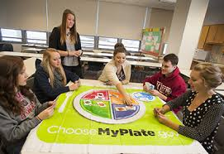
HUSC Degree Program SLOs
Hum Sci - To explain how their major impacts the lives of individuals families and community
Hosp Tour Mgmt – new program

Slide 34
Example: AG Sci Curriculum map
Go to excel file of curriculum map…

Slide 35
Senior comprehensive exams
9/29/20 Memo from Provost
“Individual departments will decide how or if to administer the senior comprehensive examination this semester. After this semester, this examination will be revamped and included as part of a capstone course.”

Slide 36
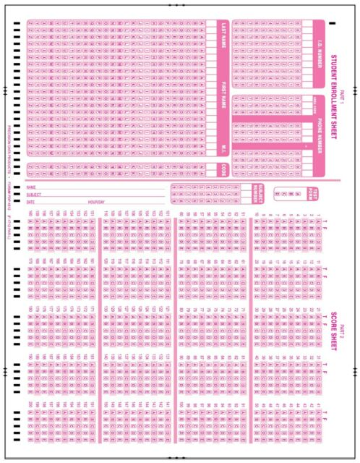
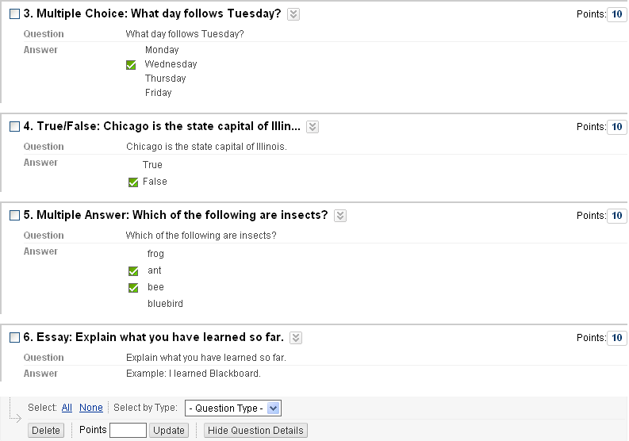
Senior comprehensive exams
Pencil & Paper Blackboard

Slide 37
Curriculum maps
Get ready for 2122AY
Written Communication, Reading
Global Learning, Human Needs and Global Environment
New Degree Program SLO

